Slide 1



SESSION NAME HERE
NON - LINEAR DATA STRUCTURES (Part 2)

Slide 2


Foundational Sessions Housekeeping
The use of disrespectful language is prohibited in the questions, this is a supportive, learning environment for all - please engage accordingly. (FBV: Mutual Respect.)
No question is daft or silly - ask them!
There are Q&A sessions midway and at the end of the session, should you wish to ask any follow-up questions. Moderators are going to be answering questions as the session progresses as well.
If you have any questions outside of this lecture, or that are not answered during this lecture, please do submit these for upcoming Open Classes. You can submit these questions here:
SE Open Class Questions or DS Open Class Questions

Slide 3
Foundational Sessions Housekeeping cont.
For all non-academic questions, please submit a query: www.hyperiondev.com/support
Report a safeguarding incident: www.hyperiondev.com/safeguardreporting
We would love your feedback on lectures: Feedback on Lectures

Slide 4


Reminders!
Guided Learning Hours
By now, ideally you should have 7 GLHs per week accrued. Remember to attend any and all sessions for support, and to ensure you reach 112 GLHs by the close of your Skills Bootcamp.
CONFIDENTIAL

Slide 5
Progression Criteria
✅ Criterion 1: Initial Requirements
Complete 15 hours of Guided Learning Hours and the first four tasks within two weeks.
✅ Criterion 2: Mid-Course Progress
Software Engineering: Finish 14 tasks by week 8.
Data Science: Finish 13 tasks by week 8.
✅ Criterion 3: Post-Course Progress
Complete all mandatory tasks by 24th March 2024.
Record an Invitation to Interview within 4 weeks of course completion, or by 30th March 2024.
Achieve 112 GLH by 24th March 2024.
✅ Criterion 4: Employability
Record a Final Job Outcome within 12 weeks of graduation, or by 23rd September 2024.
CONFIDENTIAL

Slide 6


Graphs
Introduction to Graphs
Types of Graphs
Prim’s Shortest Path Algorithm
Implementing Graphs in Python
Graph Traversals

Slide 7

Simulating Social Networks
Consider a social networking site, like Facebook or LinkedIn, that supports the addition of new, unique members. Members can choose to follow other members, which forms a link between them.
What data structure could be used to represent a network like this made up of members and connections?
How could we use this structure to be able to report on the total number of members in the network, the number of connections a member has and the shortest number of connections between two members?

Slide 8

Using a Graph to model a network
Can we graphically represent a network?
Use shapes to represent the members
Use lines connecting the shapes to represent the connections
Let’s try and draw this together
Can we determine the number of members?
Can we determine the number of connections a member has?
What is the shortest connection between two members?
Notes:
Worked Example in class!

Slide 9

Graphs
A non-linear data structure made up of vertices or nodes and connected by edges or arcs, that is used to represent complex relationships between objects.
Graphs are made up of two sets, the Vertices (V) and Edges (E).
Each element of E is a pair consisting of two elements from V.
Vertices can be labelled and may be a reference to an external entity with additional information known as attributes.
Edges can be labelled and the pairs can be ordered depending on the type of the graph.

Slide 10

Graphs are depicted visually using circles or boxes to represent vertices, and lines (or arrows) between the circles or boxes to represent edges. This can only be done for small datasets.
E
A
C
B
D

Slide 11
Neighbours: Two nodes that are connected by an edge. This property is also known as adjacency.
E.g. A is adjacent to B, A and B are neighbours
Degree: The number of other nodes that a node is connected to (i.e. the number of neighbours a node has).
E.g. The degree of A is 3
Loop: An edge that connects a node to itself.
Path: A sequence of nodes that are connected by edges.
E.g. (A, B, D) denoted using sequence notation ()
Cycle: A closed path which starts and ends at the same node and no node is visited more than once.
E.g. {A, C, D, B, A}

Slide 12

Types of Graphs
Undirected Graphs Edges connecting nodes have no direction. For this graph, the order of the pairs of vertices in the edge set does not matter. Applications: Social networks, Recommendation Systems
Directed Graphs Edges connecting nodes have specified directions. Edges may also be bidirectional. This graph cannot contain any loops. Applications: Maps, Network Routing, WWW
A
E
C
B
D

Slide 13
Weighted/Labelled Graphs Directed/Undirected graphs that have values associated with each of its edges. These values can record any information relating to the edge e.g. distance between nodes. Applications: Transportation Networks, Financial/Transactional Networks
Vertex Labelled Graphs Directed/Undirected graphs where the vertices/nodes in the graph are labelled with information which identifies the vertex. Applications: Biological Networks (molecular structures), Semantic Networks
2
8
6
1
3
cat
on
sat
the
mat

Slide 14

Cyclic Graphs A directed graph which contains at least one cycle. Applications: Task Scheduling, Manufacturing Processes, Finite State Machines (a mathematical model of computation)
Directed Acyclic Graphs Also known as a DAG. A directed graph with no cycles. Various use-cases across fields. Applications: Dependency Resolution Systems e.g. package management, Project Management, Compiler Design
0
0
A
0
B
1
C
*
+
+
A
B
A
Notes:
Can anyone gue the
Can anyone guess the expression represented in the graph

Slide 15


Disconnected Graphs The graph contains nodes which are not connected via an edge to any other nodes in the graph. Applications: Social Networks, Transportation Networks, Component Analysis
Connected Graphs There is a path from any node in the graph to any other node in the graph. Applications: Communication Networks, Routing Algorithms, Circuit Design, Data Analysis
userA
userC
userB
userD
userF
userE
userG

Slide 16
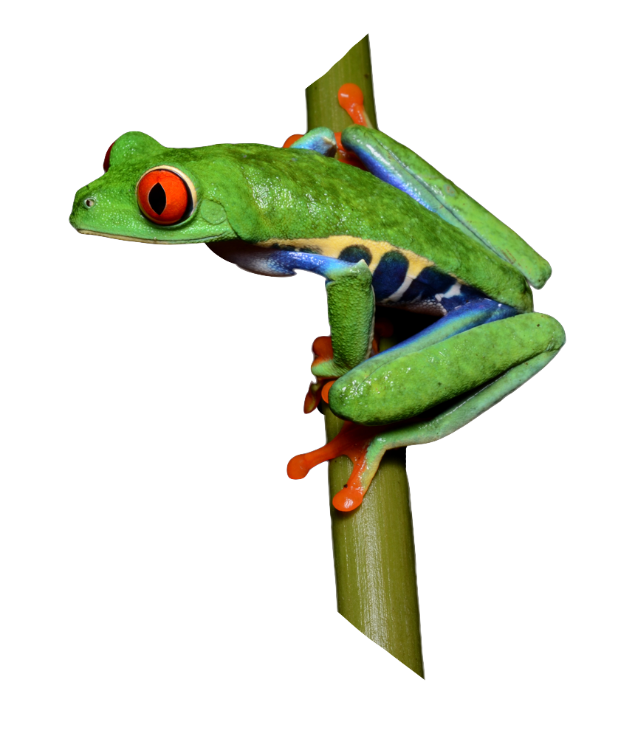
Prim’s Minimum Spanning Tree
A greedy algorithm used to find the subset of edges that form a tree that includes every vertex and that has the minimum total number of edges (and weight) for an undirected graph.
This algorithm is typically used for weighted graphs, but it can be used for unweighted graphs.
There are other algorithms which could be used to accomplish this task but this one is one of the simplest to implement and performs well for connected, weighted graphs with medium density.

Slide 17
The general method for Prim’s algorithm for weighted graphs is:
Create an empty spanning tree (referred to as MSP) and a set of all the vertices in the graph (referred to as G).
Select an arbitrary starting vertex and remove it from G.
Identify all the edges connecting the vertices in G to vertices in MSP. This set of edges is known as the cut.
Add the edge with the smallest weight to MSP and remove the vertex it connects to from G.
Repeat steps 3 and 4 until G is empty.
For unweighted graphs, in step 4 instead of choosing the edge with the smallest weight, any edge can be chosen.

Slide 18

Worked Example: Prim’s MST
Find the minimum spanning tree of the following graph:
B
2
D
4
A
3
1
5
C
2
E

Slide 19
Worked Example: Prim’s MST
Create an empty spanning tree (referred to as MST) and a set of all the vertices in the graph (referred to as G).
B
2
D
4
A
3
1
5
C
2
E

Slide 20

Worked Example: Prim’s MST
2. Select an arbitrary starting vertex, remove it from G and add it to the MST.
B
2
D
4
A
3
1
5
C
2
E

Slide 21
Worked Example: Prim’s MST
3. Identify all the edges connecting the vertices in G to vertices in MST. This set of edges is known as the cut.
B
2
D
4
A
3
1
5
C
2
E

Slide 22

Worked Example: Prim’s MST
4. Add the edge with the smallest weight to MST and remove the vertex it connects to from G and add it to the MST.
5. Repeat steps 3 and 4 until G is empty.
B
2
D
4
A
3
1
5
C
2
E

Slide 23
Worked Example: Prim’s MST
3. Identify all the edges connecting the vertices in G to vertices in MST. This set of edges is known as the cut.
B
2
D
4
A
3
1
5
C
2
E

Slide 24
Worked Example: Prim’s MST
4. Add the edge with the smallest weight to MST and remove the vertex it connects to from G and add it to the MST.
B
2
D
4
A
3
1
5
C
2
E

Slide 25
Worked Example: Prim’s MST
3. Identify all the edges connecting the vertices in G to vertices in MST.
B
2
D
4
A
3
1
5
C
2
E

Slide 26
Worked Example: Prim’s MST
4. Add the edge with the smallest weight to MST and remove the vertex it connects to from G and add it to the MST.
B
2
D
4
A
3
1
5
C
2
E

Slide 27
Worked Example: Prim’s MST
3. Identify all the edges connecting the vertices in G to vertices in MST.
B
2
D
4
A
3
1
5
C
2
E

Slide 28
Worked Example: Prim’s MST
4. Add the edge with the smallest weight to MST and remove the vertex it connects to from G and add it to the MST.
B
2
D
4
A
3
1
5
C
2
E

Slide 29

Worked Example: Prim’s MST
A
B
Total weight: 9
D
E
C

Slide 30

Greedy Algorithms: Algorithms that build solutions to a problem piece by piece, choosing each piece by whichever will have the most obvious and immediate benefit.
Usually, greedy algorithms are not the most optimal solution but they may produce an approximately optimal solution in a reasonable amount of time.
Prim’s algorithm makes a series of locally optimal decisions, in order to find the globally optimal solution.
Hence it is considered a greedy algorithm.
It has also been proven to always produce an optimal solution for connected, weighted graphs.

Slide 31

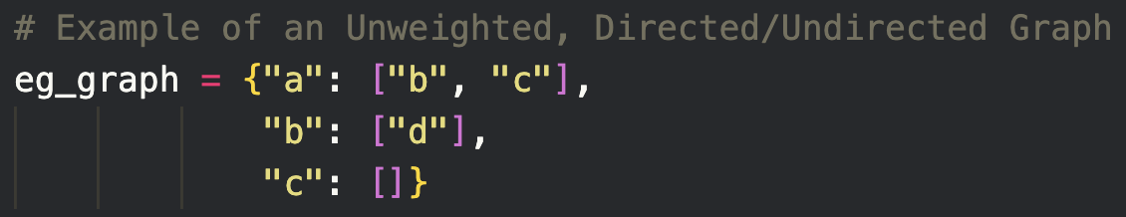
Implementation of Graphs
The simplest way to implement a graph is using dictionaries.
This method can be used for undirected graphs and edge-weighted graphs. Can anyone guess how we can do that given the implementation below?
We can use recursive functions to search for paths in the graph.

Slide 32
Graph Traversal: BFS
Breadth First Search (BFS) is a fundamental graph traversal algorithm. It involves visiting all the connected nodes of a graph in a level-by-level manner. In this article, we will look into the concept of BFS and how it can be applied to graphs effectively
Steps:
Initialization: Enqueue the starting node into a queue and mark it as visited.
Exploration: While the queue is not empty:
Dequeue a node from the queue and visit it (e.g., print its value).
For each unvisited neighbor of the dequeued node:
Enqueue the neighbor into the queue.
Mark the neighbor as visited.
Termination: Repeat step 2 until the queue is empty.

Slide 33
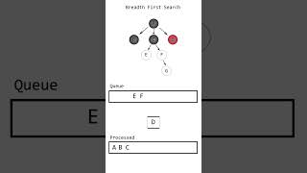
Graph Traversal: BFS

Slide 34
Graph Traversal: DFS
Depth First Traversal (or DFS) for a graph is similar to Depth First Traversal of a tree. The only catch here is, that, unlike trees, graphs may contain cycles (a node may be visited twice). To avoid processing a node more than once, use a boolean visited array. A graph can have more than one DFS traversal.
Steps:
Start by putting any one of the graph's vertices on top of a stack.
Take the top item of the stack and add it to the visited list.
Create a list of that vertex's adjacent nodes. Add the ones which aren't in the visited list to the top of the stack.
Keep repeating steps 2 and 3 until the stack is empty.

Slide 35
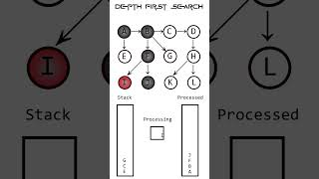
Graph Traversal: DFS

Slide 36


Thank you
for joining us
Take regular breaks
Stay hydrated
Avoid prolonged screen time
Practice good posture
Get regular exercise
“With great power comes great responsibility”

Slide 37


Questions and Answers
Questions around Non-Linear Data Structures Part 2

